Slide 1

Learning to learn with Meta-Learning
Shree Gowri Radhakrishna

Slide 2
References
This presentation is based on the paper “A COMPREHENSIVE OVERVIEW AND SURVEY OF RECENT
ADVANCES IN META-LEARNING”, authored by Huimin Peng.
[1] H. Peng. A comprehensive overview and survey of recent advances in meta-learning (2020). arXiv:2004.11149 [cs.LG].
[2] T. Hospedales, A. Antoniou, P. Micaelli, A. Storkey. Meta-Learning in Neural Networks: A Survey (2020). arXiv:2004.05439 [cs.LG].

Slide 3
What is Meta-Learning?
Learning to learn
Learn weight initialization
Learn metric space
Learn optimizers
Rapid, accurate model adaptation to unseen tasks
Applications in automated AI, zero shot learning, NLP, robotics
Similarity measure between related tasks

Slide 4
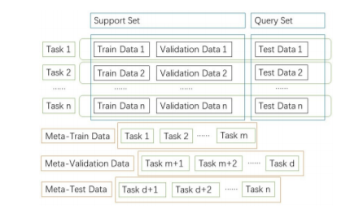
Architecture
Figure 1: Upper part of the figure shows: training data, validation data, and testing data. The lower part of the figure shows meta-training data, meta-validation-data, and meta-testing data with tasks. (H. Peng, 2020)

Slide 5
Why Meta-Learn?
Self-improvement, automated AI
Adaptation to unseen tasks, different than trained tasks

Slide 6
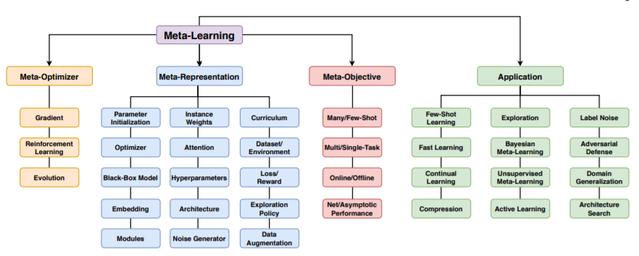
Meta Learning paradigm
Figure 2: Overview of meta-learning paradigm (T. Hospedales et al., 2020)

Slide 7
Methodologies
Black box Meta Learning
Based on neural networks
AdaResNet and AdaCNN
Metric-based Meta Learning
Based on a similarity measure
SNAIL, Relation Network, Prototypical Network, Dynamic few-shot, Mean Average Precision.
Layered Meta Learning
Base Learner + Meta Learner
MAML, Meta-LSTM, R2-D2 and LR-D2, TPN and LEO.
Bayesian Meta Learning
AI-GAs, Neural Statistician, LLAMA, BMAML and VERSA.

Slide 8
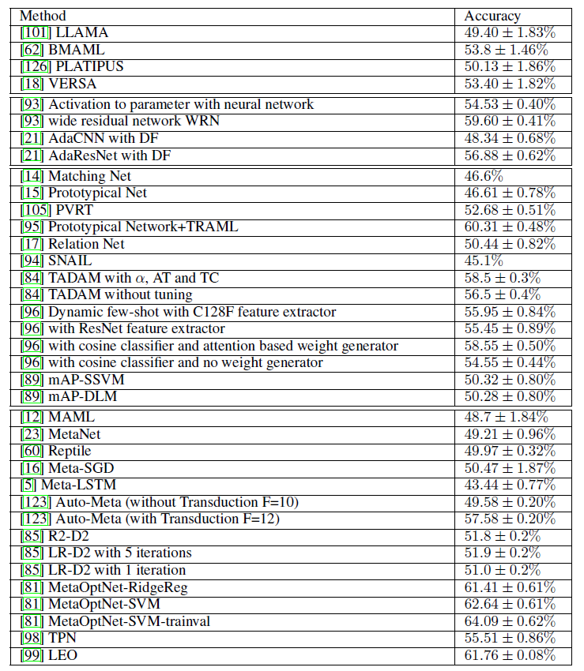

Slide 9
Applications
Robotics
Automated trading
Learning rare languages
Drug discovery – high dimensional data + small sample size

Slide 10
Thank you!

